Slide 1
ASHRAE
Advancing HVAC&R to serve humanity and promote a sustainable world…

Slide 2
Who We Are
55,579 members in over 132 countries
More than 5,400 student members
More than 180 chapters
More than 224 student branches
More than 9,530 YEA members
Consulting engineers
Contractors
Manufacturers
Manufacturing representatives
Architects
And Students

Slide 3
What We Do
Provide essential membership benefits
Serve as a pipeline for technical information to members, chapters and companies
Create standards and technical guidelines to serve the industry
Offer continuing education for industry professionals
Serve as a networking tool for industry professionals

Slide 4
How We Do It
28 standing committees
130 standards and guidelines committees
Some 100 technical committees
300 publications
Six certification programs
More than 100 educational courses
Research
78 active projects
Over 700 projects completed over last 50 years
Advocacy in Washington, DC, and locally in US states

Slide 5
What Makes Us Different
We are a global membership
Our members create our technologies
We are the leader in the HVACR industry for technical advancements
We are one of few HVAC&R organizations in world with own research program

Slide 6
Sustaining Momentum and Net Zero
Sustaining Momentum
Achieving Net Zero
u
u
Click to Connect and Play
Click to Connect and Play

Slide 7
Sustaining Momentum & Net Zero
Sustaining Momentum (click to play)

Slide 8
Sustaining Momentum & Net Zero
Achieving Net Zero (click to play)

Slide 9
ASHRAE ♥ ITS STUDENT MEMBERS
ASHRAE believes
Student members = the future of our Society and our industry
Our future standard of living depends on developing future technicians, engineers and scientists
Recognizes the return value of providing a solid foundation in science, technology, engineering and mathematics
_{v}

Slide 10
ASHRAE ♥ ITS STUDENT MEMBERS
How can ASHRAE help you?
Professional development opportunities
Networking opportunities
Access to new technology
Discounted registration to ASHRAE Annual and Winter Conference
ASHRAEjobs.org
_{v}

Slide 11
Scholarships
More students and more schools than ever eligible for ASHRAE scholarships
Two new scholarships available to high school seniors to be applied to their freshman year of college – May 1 application deadline
www.ashrae.org/scholarships
Notes:
Criteria expanded to include engineering or engineering technology programs accredited by PAHRA and accrediting bodies outside the U.S. that have signed an MOU with ABET, are part of the Washington Accord or schools with ASHRAE student branches
-includes CACEI in Mexico and CEAB in Canada

Slide 12
ASHRAE
Today’s building designs mortgage our energy future.
Notes:
With increasing energy costs and now, climate change considerations, providing design guidance related to energy efficiency is more important than ever. As energy costs increase faster than costs for building materials and products, improvements to save energy are more readily justified.

Slide 13
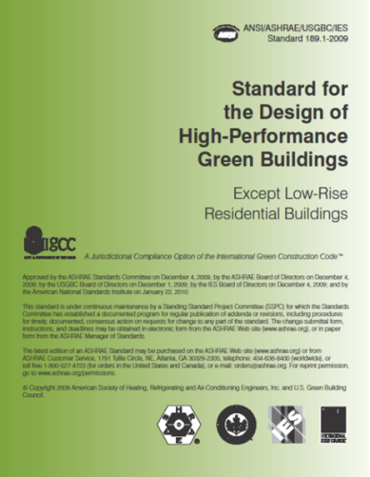
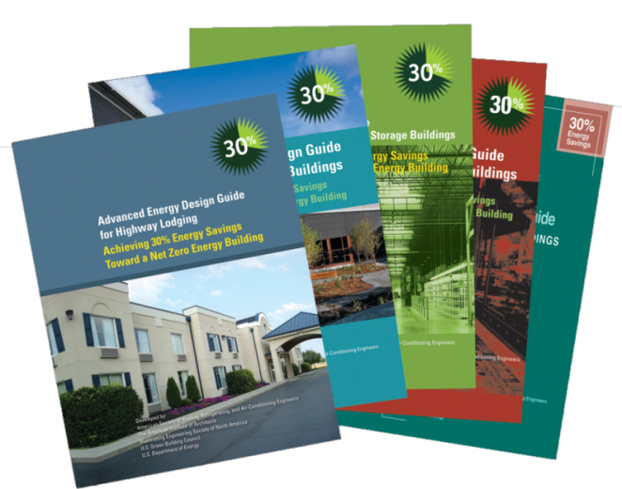
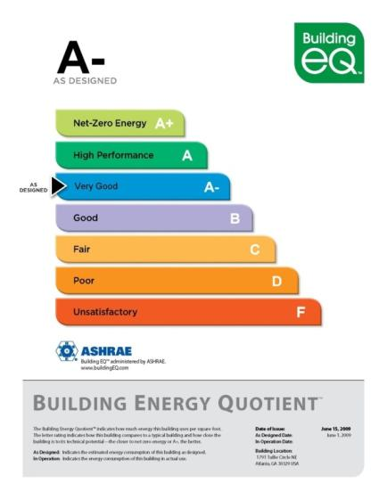
ASHRAE’s Mission
Advancing HVAC&R to serve humanity and promote a sustainable world.

Slide 14
Engineering for Sustainability
ASHRAE supports its mission by programs, publications and products such as:
Launch of Building Energy Quotient program
Publication of green building standard – Standard 189.1
Renovation of ASHRAE headquarters as a sustainable building
Publication of High Performance Building magazine
Transforming the market through the Advanced Energy Design Guide series

Slide 15
Building Energy Quotient™ ASHRAE’s Building Energy Labeling Program
Providing Valuable Information to Building Owners and Operations Staff

Slide 16
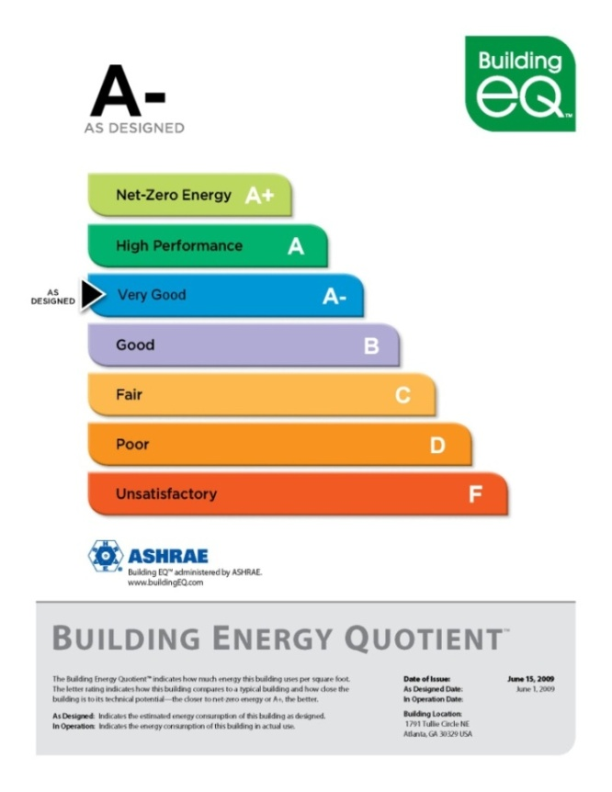
Building Energy Labels Provide. . .
Information on the potential and measured energy use of buildings
Feedback to building owners and operators on how their building is performing
Insight into the value and potential of investments for long-term energy costs
Opportunity to differentiate buildings in a technically sound and consistent manner
Notes:
ASHRAE believes that public display and disclosure of energy efficiency attributes of building and its energy use intensity will lead building owners to strongly consider cost effective energy efficiency improvements at the time of design and construction and in any subsequent renovations.
A prototype label was awarded to the ASHRAE Headquarters at the 2009 Annual Conference. More than 20 buildings involved in the In Operation pilot phase of program, representing variety of building types across the U.S.
The pilot phase of the In Operation (operational) rating completed in June 2010. The pilot phase of the As Designed (asset) rating started in March 2011.
Currently the In Operation rating is limited to buildings covered by Energy Star and the As Designed pilot is addressing only Office buildings. A research project has been proposed that will work to expand the building types covered by the program.
There are two certifications related to the program: The Building Energy Modeling Professional (BEMP) certification was launched in January 2010 and will be required for the As Designed (asset) rating. The Building Energy Assessor Professional (BEAP) was launched in February 2011 and will be required for the In Operation (operational) rating assessments.

Slide 17
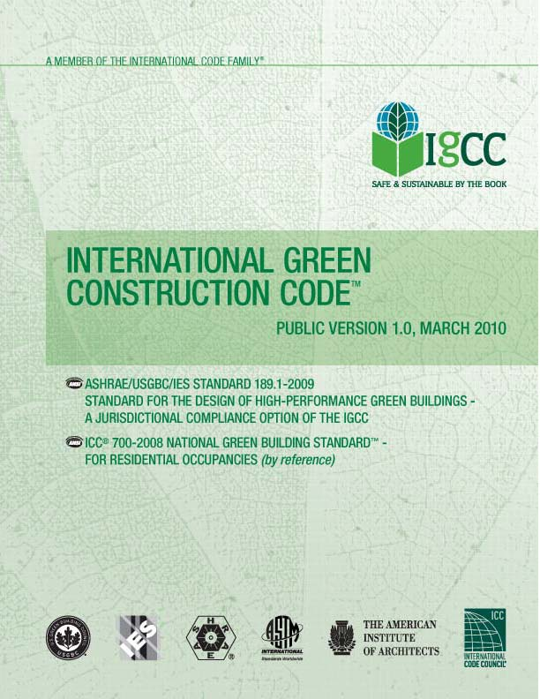
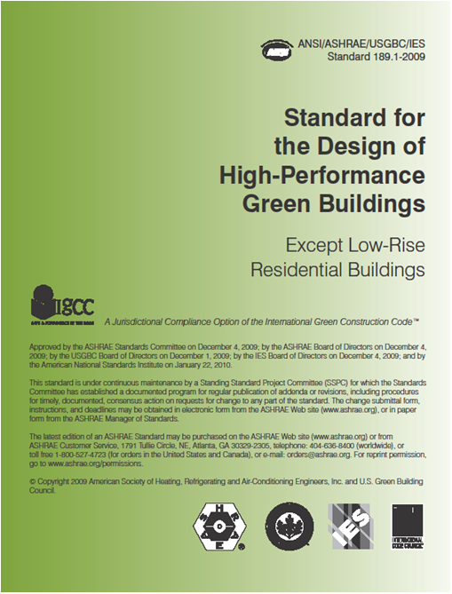
Green Building Standard
Published in January 2010
Serves as benchmark for sustainable green buildings – does not apply to all buildings
Addresses energy, impact on the atmosphere, sustainable sites, water use, materials and resources and IEQ
Jurisdictional compliance option for International Green Construction Code
www.ashrae.org/greenstandard
Notes:
Standard 189.1, Standard for the Design of High-Performance Green Buildings Except Low-Rise Residential Buildings.
Developed in conjunction with Illuminating Engineering Society of North America and U.S. Green Building Council

Slide 18
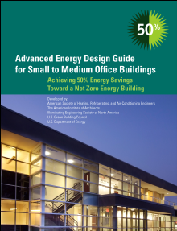
Advanced Energy Guidance
Guidance on how to save 30% energy savings over building code minimum based on Standard 90.1-1999
More than 275,000+ in circulation
Easy to read, case studies highlighted
2010 assessment found guides are positively impacting the building industry and are in line with their objective
www.ashrae.org/freeaedg
Notes:
Original series of guides provide guidance on how to achieve 30 percent energy savings over building code minimum based on 90.1-1999. The building types covered in this series are:
Small Office Buildings (up to 20K SF)
Small Retail Buildings (up to 20K SF)
K-12 Schools (all sizes)
Warehouses (up to 50K SF – Non refrigerated)
Highway Lodging (up to 4 stories, 80 rooms)
Small Hospitals (up to 90K SF)
An 2010 assessment found that these guides are positively impacting the building industry and are in line with their objective of achieving 30 percent energy savings over the minimum code requirements of ANSI/ASHRAE/IESNA Standard 90.1-1999, Energy Standard for Buildings Except Low-Rise Residential Buildings.
50% series has now been launched and will focus on achieving 50% energy savings beyond ANSI/ASHRAE/IESNA Standard 90.1-2004, Energy Standard for Buildings Except Low-Rise Residential Buildings. Four building types are currently underway (office, K-12 schools, retail, hospital) as noted in the slide.

Slide 19
Why Should You Join Today?
Membership connects you to the leaders of the world’s largest HVAC&R association
Membership offers significant opportunities for professional development and continuing education
Membership offers significant discounts on the industry’s leading standards, guidelines and technical resources
Membership offers career development resources
Membership keeps you in the loops on all of the latest advancements in the industry and with green technologies

Slide 20
Join the ASHRAE Family
Join online at www.ASHRAE.org/join
Phone ASHRAE Customer Service at (800) 5-ASHRAE (527-4723) (US & Canada) or (404) 636-8400 (International)
Email ASHRAE Customer Service at membership@ashrae.org
What are you waiting for?

